Slide 1
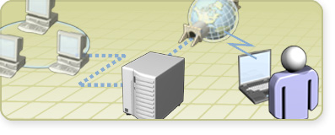
Module 1: Configuring Routing by Using Routing and Remote Access

Slide 2

Overview
Multimedia: The Role of Routing in the Network Infrastructure
Enabling and Configuring the Routing and Remote Access Service
Configuring Packet Filters

Slide 3
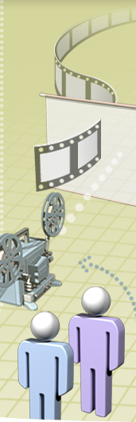
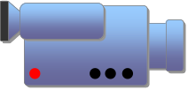
Multimedia: The Role of Routing in the Network Infrastructure
The objective of this presentation is to provide a high-level overview of routing in the network infrastructure
After this presentation, you will be able to:
  Describe how routing fits into the network infrastructure
  Explain the difference between local and remote routing
  Describe how the Microsoft routing solution fits into the network infrastructure

Slide 4
Lesson: Enabling and Configuring the Routing and Remote Access Service
What Are Routers?
What Are Routing Interfaces?
What Are Routing Protocols?
What Are Routing Tables?
Why Use the Windows Server 2003 Routing and Remote Access Service?
How to Enable and Configure the Routing and Remote Access Service
How to Add a Routing Protocol
How to Add Routing Interface to a Routing Protocol

Slide 5

What Are Routers?
Routers are an intermediate system at the network layer that is used to connect networks together based on a common network layer protocol
Router types | Example
Hardware router | A device that performs routing as a dedicated function
Software router | A router that is not dedicated to performing routing only, but performs routing as one of multiple processes running on the router computer
Main routing components include:
Routing interface
Routing protocol
Routing table

Slide 6
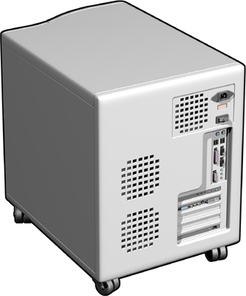
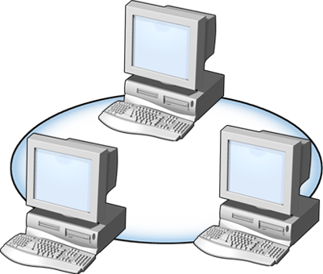
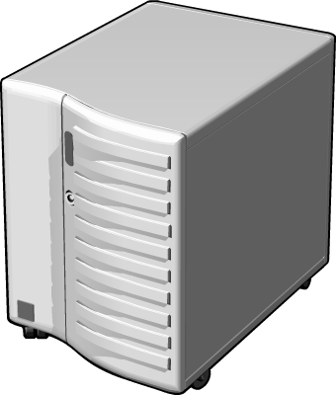
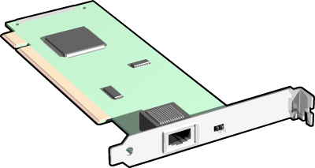
What Are Routing Interfaces?
A routing interface is an interface over which IP packets are forwarded
Two types of routing interfaces:
LAN
Demand-dial

Slide 7
What Are Routing Protocols?
A routing protocol is a set of messages that routers use to determine the appropriate path to forward data
RIP
OSPF
Designed for small to medium-size networks
Uses a routing table
Easier to configure and manage
Does not scale well
Designed for large to very large networks
Uses a link-state database
Complex to configure and manage
Operates efficiently in large networks

Slide 8
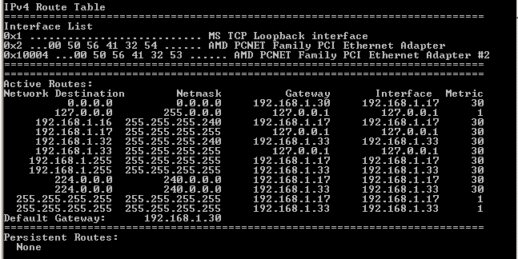
What Are Routing Tables?
A routing table is a series of entries called routes that contain information about the location of the network IDs in the internetwork
Three types of routing table entries:
Network route
Host route
Default route

Slide 9
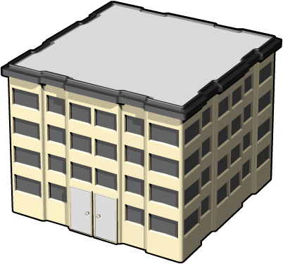
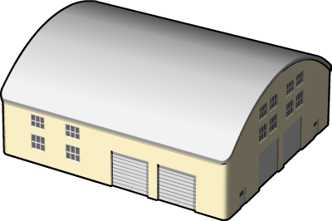
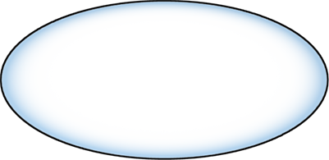
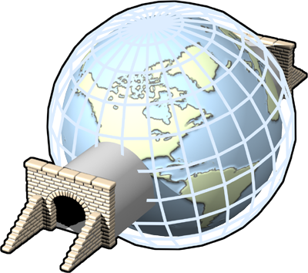
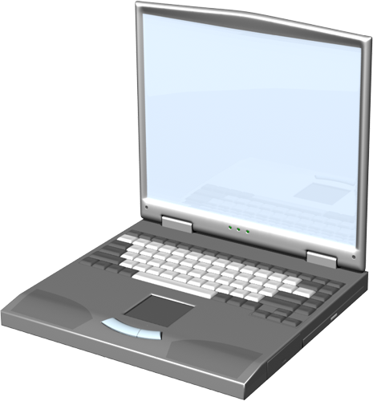

Why Use the Windows Server 2003 Routing and Remote Access Service?
Windows Server 2003 Routing and Remote Access is a service that performs routing as one of its multiple processes
Internal Subnets
Remote Site Using Demand-dial
LAN
LAN
Remote
Site
Corp Net
Corp Net
Remote Access Using VPN Tunnel
Corp Net

Slide 10
How to Enable and Configure the Routing and Remote Access Service
Your instructor will demonstrate how to enable and configure the Routing and Remote Access service

Slide 11
How to Add a Routing Protocol
Your instructor will demonstrate how to add a routing protocol

Slide 12
How to Add a Routing Interface to a Routing Protocol
Your instructor will demonstrate how to add a routing interface to a routing protocol

Slide 13
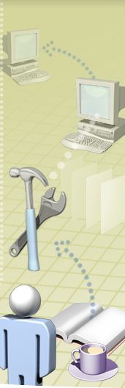
Practice: Enabling and Configuring the Routing and Remote Access Service
In this practice, you will enable and configure routing on the server computer

Slide 14
Lesson: Configuring Packet Filters
What Is Packet Filtering?
How Packet Filters Are Applied
How to Configure Packet Filters

Slide 15
What Is Packet Filtering?
Packet filtering specifies what type of traffic is allowed into and out of a router
A packet filter is a TCP/IP configuration setting that is designed to allow or deny inbound or outbound packets
Inbound Filter
Router
Outbound Filter
Use packet filtering to:
Prevent access by unauthorized users
Prevent access to resources
Improve performance by preventing unnecessary packets from traveling over a slow connection

Slide 16
How Packet Filters Are Applied
Packet
Router
Component | Example
Source network
Destination network
Protocol
192.168.0.48
Inbound Exclusion Filter
192.168.0.32
Component | Example
Source network
Destination network
Protocol
Any
UDP
192.168.0.32
How filters are applied:
UDP
AND is used within a filter
OR is used between filters
Action: Drop

Slide 17
How to Configure Packet Filters
Your instructor will demonstrate how to configure packet filters

Slide 18
Practice: Configuring Packet Filters
In this practice, you will configure a packet filter

Slide 19

Lab A: Configuring Routing by Using Routing and Remote Access
In this lab, you will identify and resolve common issues when configuring routing and packet filters

